Slide 1



DIRECT-TO-EMPLOYER PLAN OPPORTUNITY FOR TAMPA GENERAL HOSPITAL
SEPTEMBER 9, 2024

Slide 2


Market Leader in Private Labeled DTE Plans
Louisville, KY
OneHealth Plan
Cincinnati, OH
TCH Optimal
Bentonville, AR
Northwest Health Plan
Knoxville, TN
East Tennessee Health Plan
Meridian, MS
Affinity Health Plan
Fort Myers, FL
Lee Health Care Partners

Slide 3

Direct-to-Employer (DTE) Your Health Plan Focused on a Direct Relationship with Self-Funded Employers in Your Market
YOU Pick the Name of the Health Plan
YOU Determine the Fees Charged
YOU Practice the Medicine
YOU Receive the Profits
WE Make it Successful

Slide 4
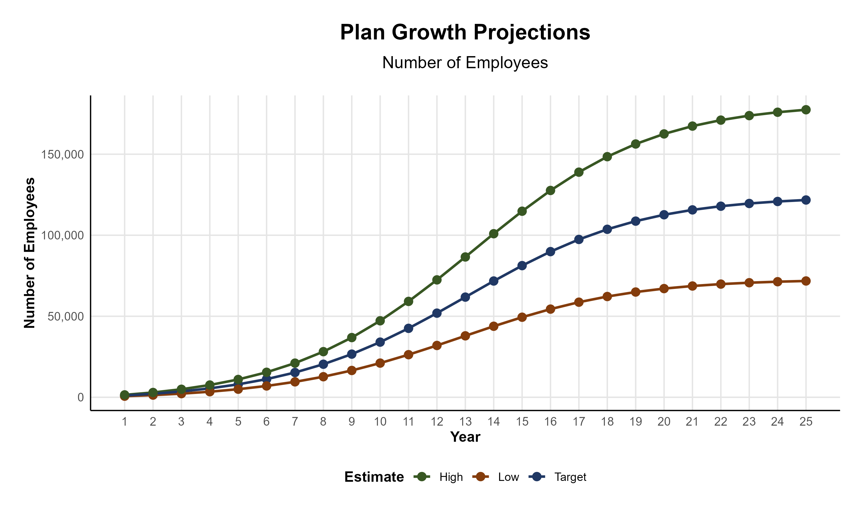
Plan Potential Growth Paths
Self Funded
807K
PLAN GROWTH POTENTIAL
1,332K
Insured
Working Age
1,984K
Population
3,403K
Estimates include Hillsborough, Manatee, Pasco, and Pinellas Counties

Slide 5
Direct-to-Employer Strategy: Only Available to Premier Health Systems
STRONG Brand Quality
EXTENSIVE Patient Access
AFFORDABLE Value Pricing
EXCELLENT Care Quality

Slide 6

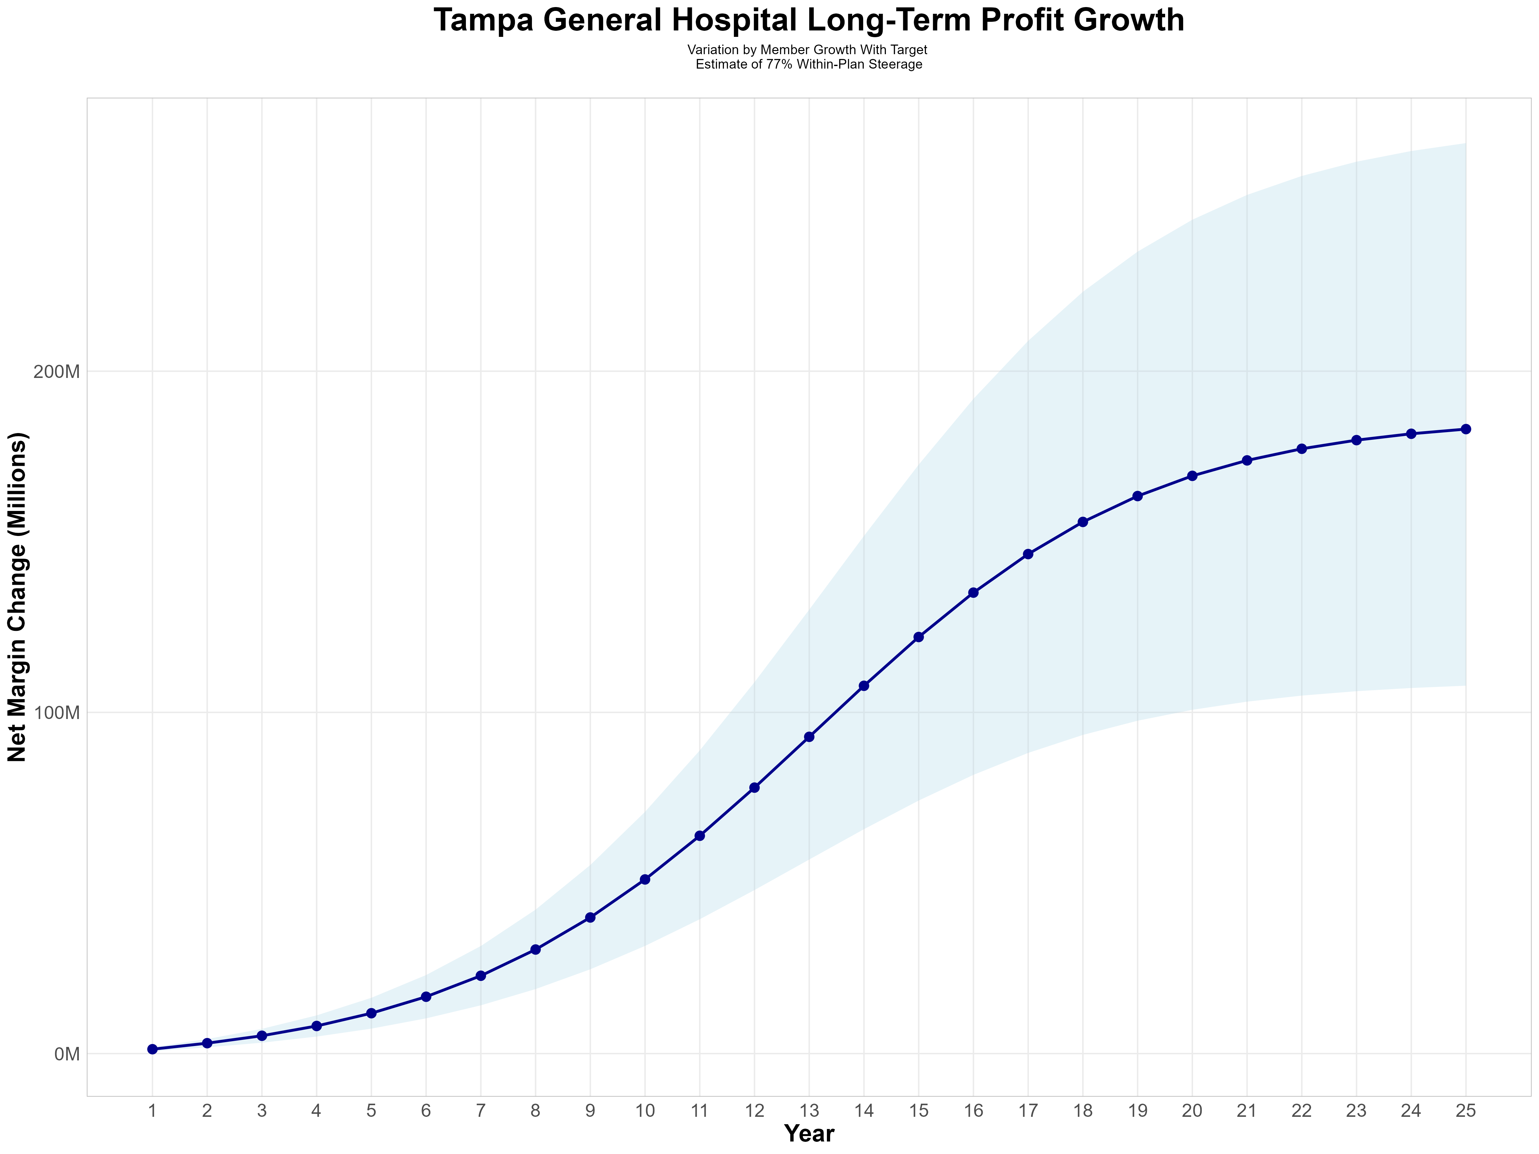
Growing Powerful, Lasting Profitability
Early Stage
Graining Name Recognition, Early Growth
New Revenue:
New Profit:
$75.23M
$12.43M
Growth Stage
Strong Reputation, Strong Growth
New Revenue:
New Profit:
$515.13M
$86.32M
Mature Stage
High Profitability, Market Saturation
New Revenue:
New Profit:
$1013.84M
$170.06M

Slide 7
SINGLE YEAR SUMMARY
DTE Covered Members Financial Analysis | DTE Covered Members Financial Analysis | DTE Covered Members Financial Analysis | DTE Covered Members Financial Analysis | DTE Covered Members Financial Analysis | DTE Covered Members Financial Analysis | DTE Covered Members Financial Analysis | DTE Covered Members Financial Analysis
Target Estimate of 77% Within-Plan Steerage. | Target Estimate of 77% Within-Plan Steerage. | Target Estimate of 77% Within-Plan Steerage. | Target Estimate of 77% Within-Plan Steerage. | Target Estimate of 77% Within-Plan Steerage. | Target Estimate of 77% Within-Plan Steerage. | Target Estimate of 77% Within-Plan Steerage. | Target Estimate of 77% Within-Plan Steerage.
DTE Members | Pre-DTE Revenue | Pre-DTE Margin | DTE Revenue | DTE Incr. Revenue | DTE Total Margin | DTE Incr. Margin | Net Margin Less DTE Fees
100 | $ 131K | $ 29K | $ 1,027K | $ 896K | $ 177K | $ 148K | $ -181K
500 | $ 656K | $ 146K | $ 5,137K | $ 4,481K | $ 887K | $ 740K | $ 416K
1,000 | $ 1,312K | $ 292K | $ 10,275K | $ 8,962K | $ 1,773K | $ 1,481K | $ 1,163K
2,500 | $ 3,281K | $ 730K | $ 25,687K | $ 22,406K | $ 4,433K | $ 3,702K | $ 3,402K
10,000 | $13,125K | $2,921K | $102,749K | $ 89,624K | $17,730K | $14,809K | $14,599K
20,000 | $26,249K | $5,842K | $205,498K | $179,249K | $35,460K | $29,618K | $29,528K
NOTE: Please see detailed financial analysis and assumptions used starting on page 23.
Financial projections do not include 340B contribution margin, which could represent $136 PMPM by optimizing 340B through Rx plan design, TGH’s approved site(s) with network integration, and development of TGH’s proprietary PBM program.

Slide 8



Founded in 1979 and headquartered in Indianapolis, IN​
Full-service TPA specializing in the administration of self-funded health plans and population health management​
One of the country’s largest independently-owned TPAs
The Key Family is a commonly-held group of benefits related organizations with:​
3,000+ corporate clients​
3.0 million members under management​
700 Employees
Exclusive Relationships
We know The Market – Agents, Networks, and MGAs

Slide 9





A Partner You Can Trust
OUR OBJECTIVES ARE ALIGNED
WE KNOW THE
MARKET
COMPLETELY TRANSPARENT
WE HAVE THE SOPHISTICATION AND INFRASTRUCTURE TO EFFECTIVELY COMPETE
Derek Moore, Senior Vice President – KBA
845-283-9973 * derek.moore@keybenefit.com

